Slide 1
KEYLOGGING & SECURITY INVESTIGATION USING PYTHON
CAPSTONE PROJECT
Presented By:
Sheeba Janet,
Artificial Intelligence & Data Science,
Jeppiaar Institute of Technology.

Slide 2
OUTLINE
Problem Statement (Should not include solution)
Proposed System/Solution
System Development Approach (Technology Used)
Algorithm & Deployment
Result (Output Image)
Conclusion
Future Scope
References

Slide 3
Problem Statement
In today's digital age, where cybersecurity threats loom large, one of the significant concerns is the proliferation of keyloggers, stealthy software tools designed to monitor and record keystrokes on a user's computer without their knowledge. Keyloggers pose a severe threat to individuals and organizations as they can capture sensitive information such as passwords, credit card details, and other personal data, leading to identity theft, financial loss, and privacy breaches.

Slide 4
Proposed Solution
To counter this threat, our proposed solution involves the development of a robust keylogger detection and prevention system. This system aims to proactively identify and thwart keylogging activities, thereby safeguarding users' keystrokes from unauthorized interception.
By leveraging advanced detection algorithms and real-time monitoring techniques, our system provides users with the means to detect and mitigate keylogging attempts effectively. Through a user-friendly interface, individuals can monitor keyboard events, receive alerts on suspicious activities, and take appropriate actions to protect their data and privacy.
The key objectives of our proposed solution are to:
Detect and identify potential keylogging activities in real-time.
Provide users with actionable insights and alerts to mitigate threats promptly.
Implement preventive measures to safeguard keystrokes from unauthorized interception.
Ensure user-friendly operation and seamless integration into existing systems.
Through the development and deployment of this comprehensive keylogger detection and prevention system, we aim to enhance cybersecurity measures and empower users to safeguard their digital assets effectively.

Slide 5
System Approach
Our system utilizes Python programming language for its flexibility and ease of implementation. We employ the pynput library for capturing keyboard events and Tkinter for creating the user interface. JSON is utilized for storing keystroke data, facilitating easy retrieval and analysis.

Slide 6
Algorithm & Deployment
The keylogger detection algorithm employed in our system utilizes a combination of techniques to monitor and analyze keyboard events in real time. Upon detecting a key press, the system captures the keystroke and evaluates it against predefined criteria to determine potential keylogging activities.
The algorithm consists of the following steps:
Keyboard Event Monitoring: The system continuously monitors keyboard events using the pynput library in Python. When a key is pressed, the event is captured and processed by the detection algorithm.
Keystroke Analysis: Each keystroke is analyzed to identify patterns and behaviors indicative of keylogging activities. This includes monitoring for repetitive keystrokes, unusual input patterns, and suspicious behavior.
Threat Identification: Based on the analysis results, the system identifies potential keylogging attempts and classifies them according to their severity. Suspicious activities trigger alerts and notifications to users, enabling them to take appropriate action.
Prevention Measures: In addition to detection, the system implements preventive measures to mitigate keylogging threats. This includes blocking malicious processes, restricting unauthorized access to keystrokes, and enhancing system security measures.
Deployment of the keylogger detection and prevention system involves integrating the algorithm into a user-friendly GUI application using the Tkinter library. The application provides users with intuitive controls and real-time updates on keyboard events, empowering them to monitor and protect their keystrokes effectively. Through seamless deployment and operation, our system aims to enhance cybersecurity measures and mitigate the risks associated with keylogging.

Slide 7
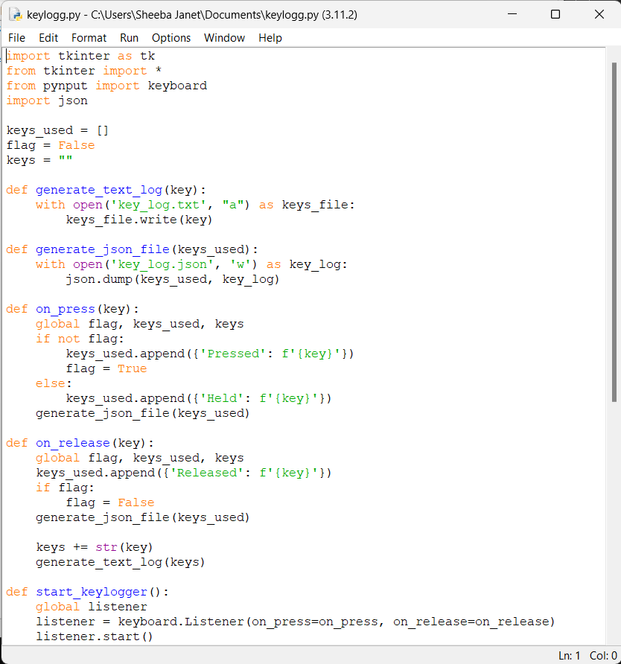
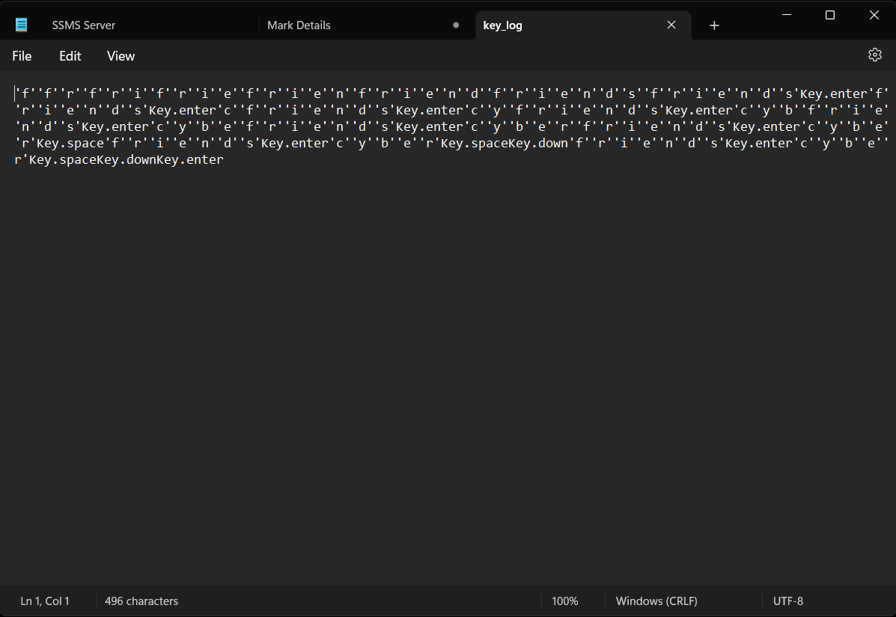
Result

Slide 8
Conclusion
In conclusion, the development of a keylogger detection and prevention system is crucial in mitigating the risks associated with keylogging. By implementing proactive measures, users can safeguard their sensitive data and protect themselves from cyber threats.

Slide 9
Future scope
The future scope of this project includes enhancing the detection algorithm to recognize advanced keylogging techniques and integrating additional security features. Furthermore, extending the system to support cross-platform compatibility and incorporating machine learning for dynamic threat detection are potential avenues for improvement.

Slide 10
References
Bhattacharya, S., & Chakraborty, S. (2020). Keylogging Detection Using Machine Learning Techniques. In 2020 IEEE 11th Annual Information Technology, Electronics and Mobile Communication Conference (IEMCON) (pp. 0549-0555). IEEE.
Ganesan, S., & Sakthivel, S. (2018). A Survey on Keylogger Detection Techniques and Prevention Mechanisms. International Journal of Advanced Research in Computer Engineering & Technology (IJARCET), 7(2), 71-75.
Python Software Foundation. (n.d.). Python Language Reference. Retrieved from https://docs.python.org/3/reference/index.html

Slide 11
THANK YOU

